Slide 1


Professional Help for PowerShell Modules
June Blender
Technology Evangelist
SAPIEN Technologies, Inc.
Microsoft Cloud & Datacenter MVP
@juneb_get_help

Slide 2
Tested Versions
The information and code used in this presentation were tested with the following system attributes.
Windows PowerShell 3.0, 4.0, 5.0.10586.122, 5.0.14279.1000, 5.1.14393.187, 5.1.14936.1000
PowerShell 6.0.0.9, 6.0.0.10 (Windows 10 Pro and Mac OS X)
Windows 7 Pro RTM, Windows Server 2012 R2 Ultimate, Microsoft Windows 10 Pro 10.0.14393 (x64), Windows Server 2012 R2 (x64), Microsoft Window 10 Home Insider Preview 10.0.14936
Contact: June Blender, @juneb_get_help, juneb@sapien.com

Slide 3
Slides & Code for All Talks
https://github.com/juneb
https://github.com/juneb/PowerShellHelpDeepDive

Slide 4
Agenda
Why write help -- for modules?
Rules & Syntax
Comment-based help v. XML help
Improve the content
Write great cmdlet help - Use checklists
Writing great About Help
Re-purposing Github wiki

Slide 5
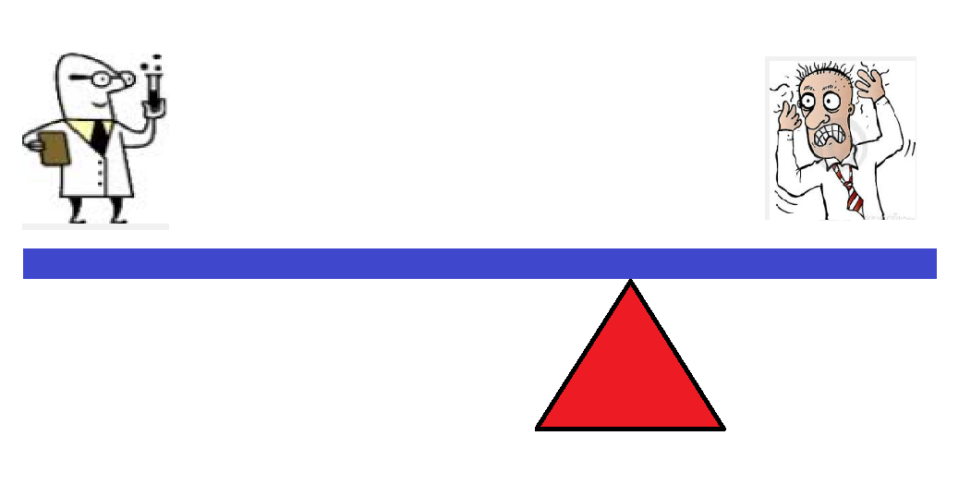
I'm too busy to write help... ... shifting the burden
Inefficient
Notes:
Direct positive correlation

Slide 6
Undocumented tool -EQ Unautomated process
Undocumented tool -EQ Unautomated process
Inefficient
Inefficient

Slide 7
Why write help for a module?
Why write help for a module?
Likely to share it
Like to keep it (and need to maintain it)
More complex than a script
More valuable

Slide 8
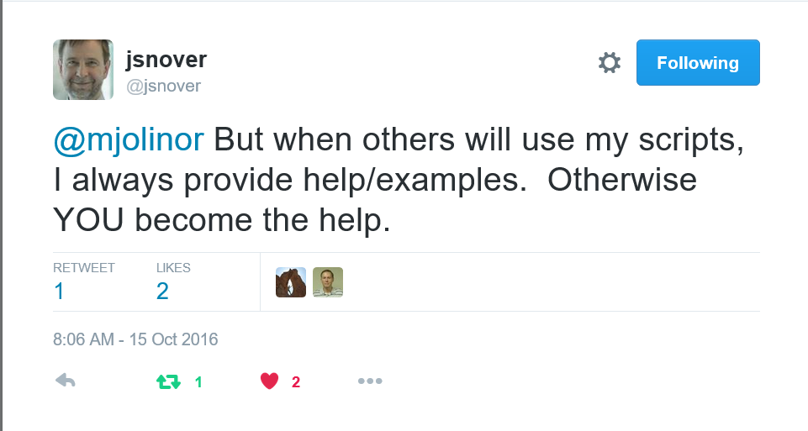

Slide 9
How is module help different?
Examples are intertwined
About topic (at least one; typically more)
Benefit from "Get-Help -Online"

Slide 10
Don't write help for your own module
Find a writer. Get a buddy
Immersed in the implementation
Need a beginner perspective focused on the user experience

Slide 11
Benefits to the Author of Writing Help
It makes you a better blogger and instructor
Writing help as a code spec ("Help-Driven Development")
Examples → Pester Tests
Notes:
Practice in explaining concepts and writing instructions; People who write good help are good instructors; People who are good instructors write good help

Slide 12
"Help-Driven Development" Help as a code specification
Description: Describe the UI.
Examples:
Which parameters you need
Recognizable parameter names
Parameter attributes
Parameter combinations -> parameter sets
Expected outcomes for testing
Inputs: Coordinate types with other cmdlets
Outputs: Define return values
DEMO: New module from help file
PowerShell Help Deep Dive (YouTube)
Advanced Help for Advanced Functions

Slide 13
"Help-Driven Development" Help Examples as a Pester test spec
Help examples are user contract
Supports behavior-driven development
Supports "white box" testing
Test input possibilities
Test piping between cmdlets
Real World Test-Driven Development with Pester
https://github.com/juneb/PesterTDD
Notes:
Force you to confront issues that you'd rather forget; but that users will encounter

Slide 14
Mechanics: A few hints about help syntax...

Slide 15
Don't forget the files!
Missing About topics in PS 5.0
Download them: https://github.com/kilasuit/Install-AboutHelp
Missing Provider help: Fixed in 5.1.
Update-Help
Invalid custom cmdlet help XML: Fixed now by @PowerShell_Team
Update-Help

Slide 16
Comment-based help v. XML help
Command Type | XML Help | Comment-Based Help
CIM Commands | X
Cmdlets | X
Functions | X | X
Providers | X
Scripts |  | X
Workflows | X | X (4.0+)

Slide 17
Comment-Based Help - Costs/Benefits
Benefits
Easy
Help always matches code
Costs
Not supported for cmdlets, providers, CIM commands
No updatable help
No multi-language support
FRAGILE !
DEMO

Slide 18
What can go wrong with comment-based help?
One keyword typo, all ignored
One misplaced value, all ignored
More than one empty line between help and function
Fewer than 2 empty lines after script comments
Troubleshooting Comment-Based Help
Notes:
What if you hedge your bets and use both.
In a script module with correctly-formatted .EXTERNALHELP, an error in comment-based help -> autogenerated help

Slide 19
XML Help - Costs / Benefits
Benefits
All command types (cmdlets/functions/workflows/CIM commands)
Updatable Help
Multiple spoken languages
Robust; error-safe
Separates help from code (Github)
Costs
PSMAML XML or Markdown file -> XML
Help might not match code
Writing XML Help for Functions

Slide 20
What can go wrong with XML help?
Naming XML help files
Missing #.ExternalHelp keyword in functions
(3.0 file names)
Comment-based help takes precedence over XML help
# .ExternalHelp keyword takes precedence over comment-based help
Command not found (Get-Help uses Get-Command)
Invalid schema (rare; pretty forgiving)
Writing XML Help for Functions
Notes:
Dynamic parameters
What if you hedge your bets and use both.
In a script module with correctly-formatted .EXTERNALHELP, an error in comment-based help -> autogenerated help

Slide 21
Naming XML Help Files for Cmdlets, CIM commands, Workflows
<SourceFile>-help.xml (2.0+) MSFT_NetQosPolicy.cdxml-help.xml
Microsoft.PowerShell.Archive.dll-help.xml
<ModuleName>-help.xml (4.0+)
AssignedAccess-help.xml
Microsoft.PowerShell.ODataUtils-help.xml
Writing XML Help for Functions

Slide 22
Naming XML Help Files for Functions
PowerShell 3.0+ No filename requirements. Requires # .ExternalHelp comment keyword*
# .ExternalHelp MyModule.psm1-help.xml # .ExternalHelp wackyTacky.xml
PowerShell 4.0 option
<ModuleName>-help.xml
Does not require #.ExternalHelp comment (ignored)
Manifest modules (4.0)
Script modules (5.0)
Writing XML Help for Functions

Slide 23
.ExternalHelp keyword
Associates a function with an XML help file
# .ExternalHelp <filename>-help.xml
function MyFunction {}
3.0: Required for functions
4.0: Required only for SourceFile-named XML help files in script modules
DEMO
Writing XML Help for Functions

Slide 24
Where do I put help files? XML, About
In language-specific subdirectory of a module directory, e.g. en-US
In the root of the module directory
In the subdirectory of the module directory (should work...)
Writing XML Help for Functions

Slide 25
Keep it simple (XML guidelines)
Use source-file naming
Use #.ExternalHelp
Place help files in language-specific subdirectory (en-US)
Don't mix comment-based/XML help

Slide 26
Test your help
Use Pester tests: Module.Help.Tests.ps1
Test manually
Get a friend to test your help

Slide 27
It's all about the content!
PowerShell Help Deep Dive (GitHub)

Slide 28
Code comments v. help
"I have code comments. Isn't that enough?"
"I'll just put my code comments in comment-based help."
What's different? They're opposites!
Audience
Perspective
Subject

Slide 29
Easy (help) writing rules
Use clear, simple language
Get, not "retrieve"
Use, not "utilize"
Change, not "modify"
Be careful with "remove" -- is this permanent? Delete?
Use active voice
Passive: When the credentials are set ...
Active: You must enter the credentials ... To enter credentials, <do this>.

Slide 30
Easy (help) writing rules
Give instructions in the order that the user needs them.
Click Run in the Action group of the Tools tab.
Click the Tools tab and, in the Action group, click Run.

Slide 31
Easy (help) writing rules
Goal first, then instructions: (Start with "To")
Use the Format parameter to format the date.
To format the date, use the Format parameter.
Using the Credential parameter will help you to avoid Access Denied errors.
To avoid Access Denied errors, use the Credential parameter.

Slide 32
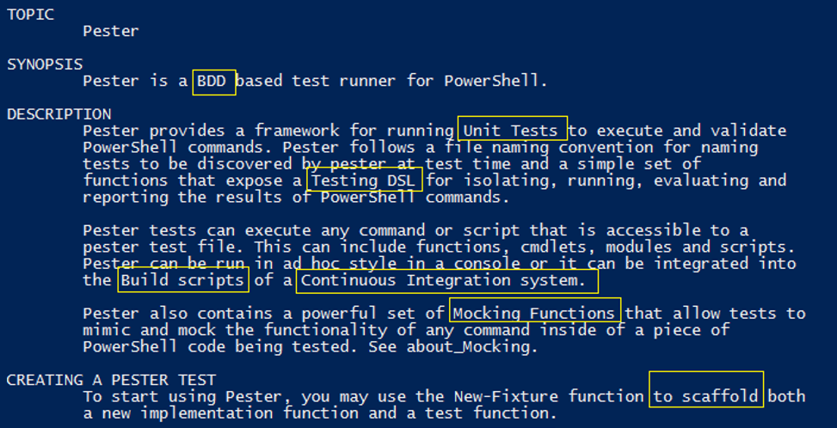
Define technical terms

Slide 33
Reuse content
You don't have to be original. Reusing is efficient.
Reuse parameter descriptions!
Use great help as a template

Slide 34
Write, use, and share checklists
Checklists for Authoring PowerShell Help on GitHub
http://github.com/juneb/PowerShellHelpDeepDive

Slide 35
Synopsis Checklist "Elevator speech" Will this cmdlet solve my problem?
Identify the technology (What kind of disk?)
Describe the action and outcome
Generic v. specific (Removes all events from the session.)
Checklists for Authoring PowerShell Help

Slide 36
Use Synopsis Checklist: Invoke-Pester (3.4.3)
Identify the technology (What kind of disk?) Testing PowerShell code
Be specific about the action and outcome. Runs *.Tests.ps1 files recursively. Others ps1 when specified.
If it's generic, say so.
All by default; parameters filter the tests
Result:
Runs all or selected Pester tests (*.Tests.ps1) in a directory and its subdirectories.

Slide 37
About Help
"Without it, your module is a confusing collection of unrelated commands."

Slide 38
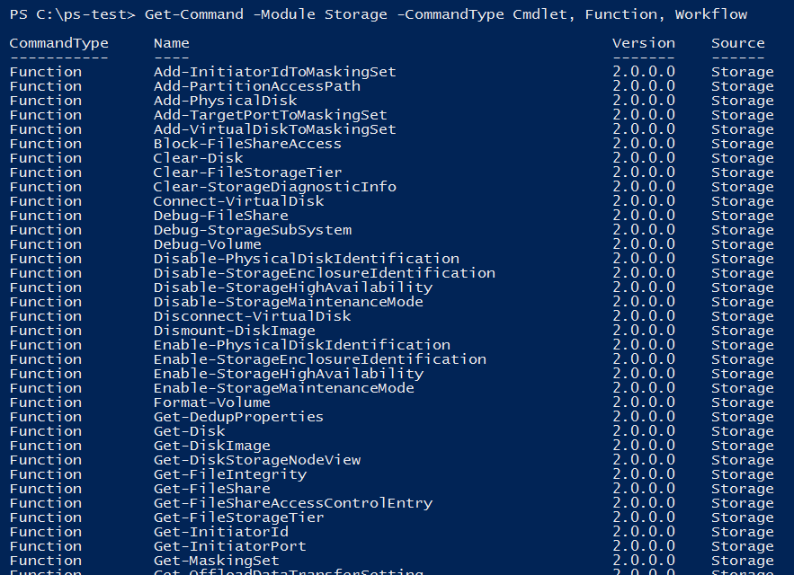
Where do I start?

Slide 39
about_<Topic>.help.txt
About Help Mechanics
Module directory
In a language-specific subdirectory

Slide 40
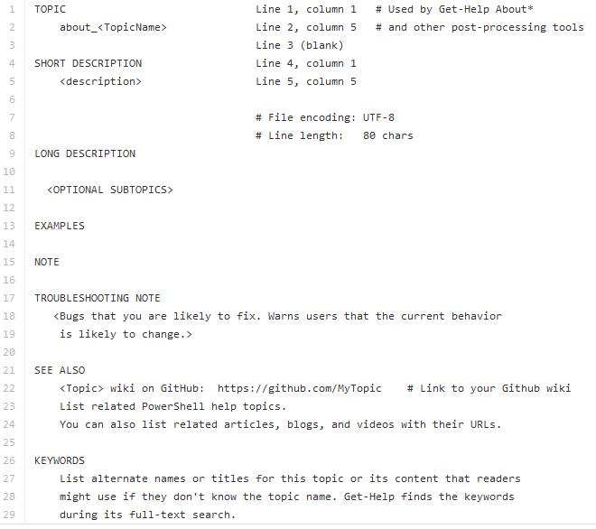
about_Topic Template : 1000-1500 words
* UTF-8 encoding
about_Topic_Template.help.txt on GitHub
Notes:
serialize

Slide 41
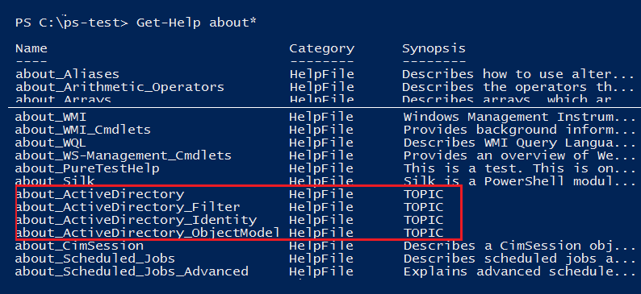
Why use the template?

Slide 42
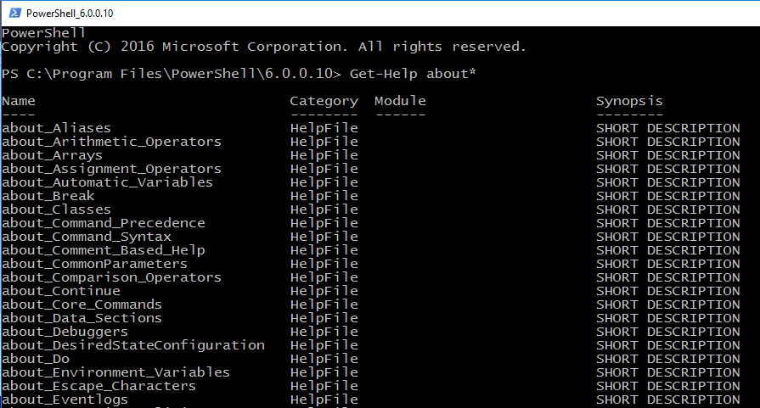
Why use the template?

Slide 43
TOPIC
about_Module|
Maybe I'll fold laundry instead.

Slide 44
About Help Checklist
"It tells the story of your module." -- Chrissy LeMaire
What problem does the module solve?
How do I use the cmdlets together to solve it?
Meta-cmdlet help
In what order do I use the commands?
Is one a prerequisite?
Is one designed to pipe to another?
Examples+++

Slide 45
about_Pester

Slide 46
Short Description
1-2 paragraphs that describe the concept.
"Will this module solve my problem?"
In which domain or technology does it work?
System requirements
If the topic is long, list the subtitles in this section, like a table of contents.

Slide 47
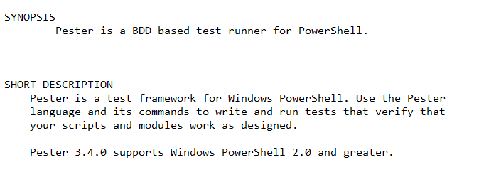
Short Description

Slide 48
Long Description Start with an outline
Brainstorm your subtopics.
Arrange subtopics in an order useful to the reader.
Simple to complex
Basic to advanced
Required order: Get/Set
Write a sentence or paragraph for every subtopic.
Reorder subtopics. Best order for the reader.
Have a friend read it.

Slide 49
Long description: Typical ordered outline
Purpose / Solution / Task
Basic example
Cmdlet/Function list
How-to sections (New/Get/Set/Save)
Examples (try it)
Background info
Notes:
PowerForensics: Invoke-ForensicDD, Get-ForensicBootSector (master boot record v. guid partition table)

Slide 50
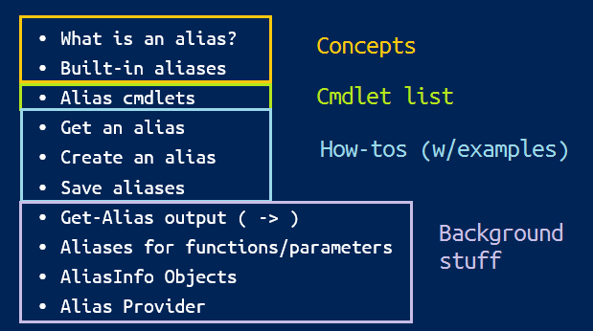
about_Aliases

Slide 51
about_Pester : Long description outline
Problem statement: Unit/integration testing
Language basics, DSL (describe, it, should be)
How-to: Create, Write, Run
How to save; default output is Write-Host
Example. Try it.
Real-world examples (from original file)

Slide 52
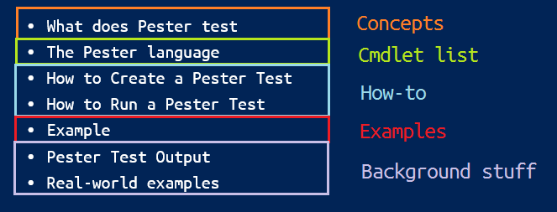
about_Pester : Long description final
What does Pester test (concepts)
The Pester language (basics + example)
How to Create a Pester Test
How to Run a Pester Test
Example
Pester Test Output (Write-Host v. custom object)
Real-world examples (Pester's own tests)

Slide 53
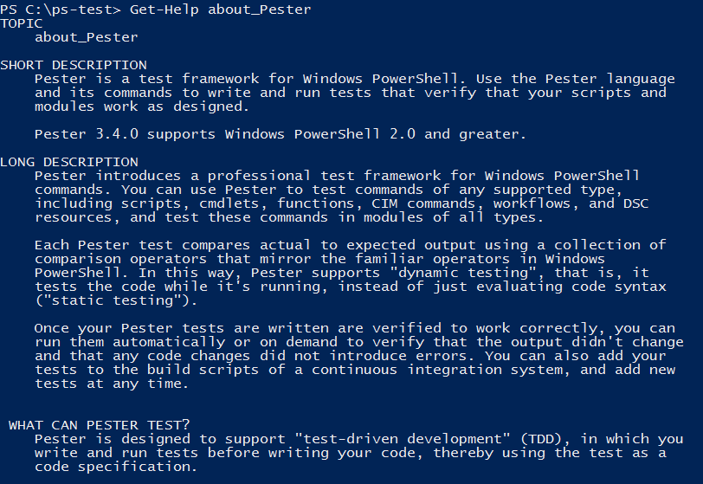
Help for Pester 3.4.1+

Slide 54
Can I use my GitHub wiki?
YES!!
It's online help!

Slide 55
Supporting "Get-Help -Online"
PS C:\>Get-Help Get-Widget -Online
Not valid for About help
Two ways to specify an online help URI for a command:
-- First related link in help topic (precedence)
-- HelpUri attribute
Supporting Online Help (MSDN)

Slide 56
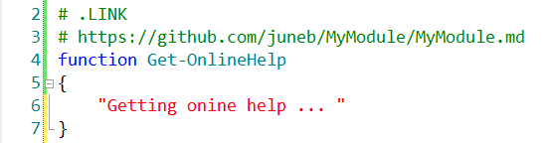
Supporting Online Help: First related link
First related link in help topic
-- Value must begin with 'http' or 'https'
Helpuri-v-HelpInfoUri
Supporting Online Help (MSDN)

Slide 57
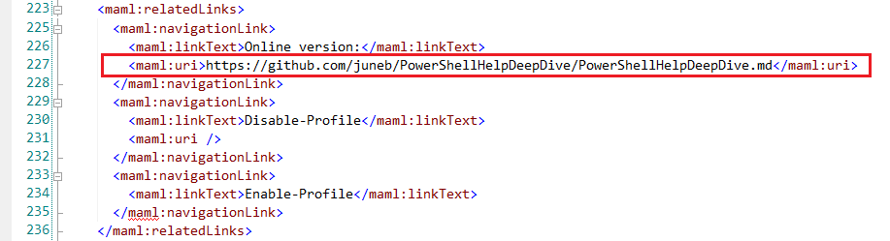
Supporting Online Help: First related link
First related link in help topic
-- Value must begin with 'http' or 'https'
First related link in help topic
-- Value must begin with 'http' or 'https'
Helpuri-v-HelpInfoUri
Supporting Online Help (MSDN)

Slide 58
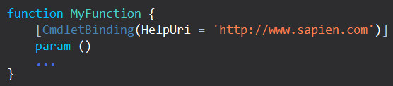
Supporting Online Help: HelpUri attribute (3.0)
Function: HelpUri attribute of CmdletBinding
C# Cmdlets: HelpUri attribute of Cmdlet class
CIM commands: HelpUri attribute of CmdletMetadata element
Helpuri-v-HelpInfoUri
Supporting Online Help (MSDN)

Slide 59
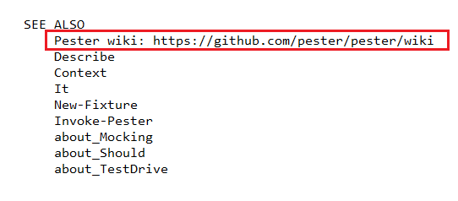
Online Help : About_help is not supported, but...
Pester Wiki (it's excellent!)

Slide 60
HelpUri v. HelpInfoUri
HelpUri: Online help
Command property
http, https
HelpInfoUri: Updatable help:
Module property
Module manifest
http only
Any web file works
Location of HelpInfo XML file
Supporting Updatable Help
Helpuri-v-HelpInfoUri

Slide 61
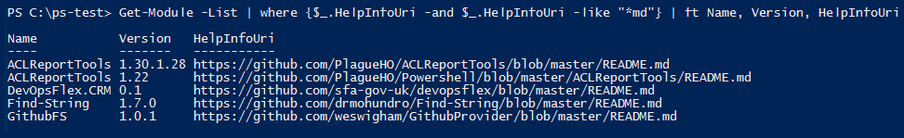
HelpInfoUri:
Updatable help
Module property
Location of HelpInfo XML file

Slide 62
Where is help for dynamic parameters?
Get-Help does not display help for parameters not defined in code (Get-Command)
Get-Help does not display help for dynamic parameters
Put dynamic parameter help in Description section
Use custom cmdlet help for providers
Writing-help-for-dynamic-parameters

Slide 63
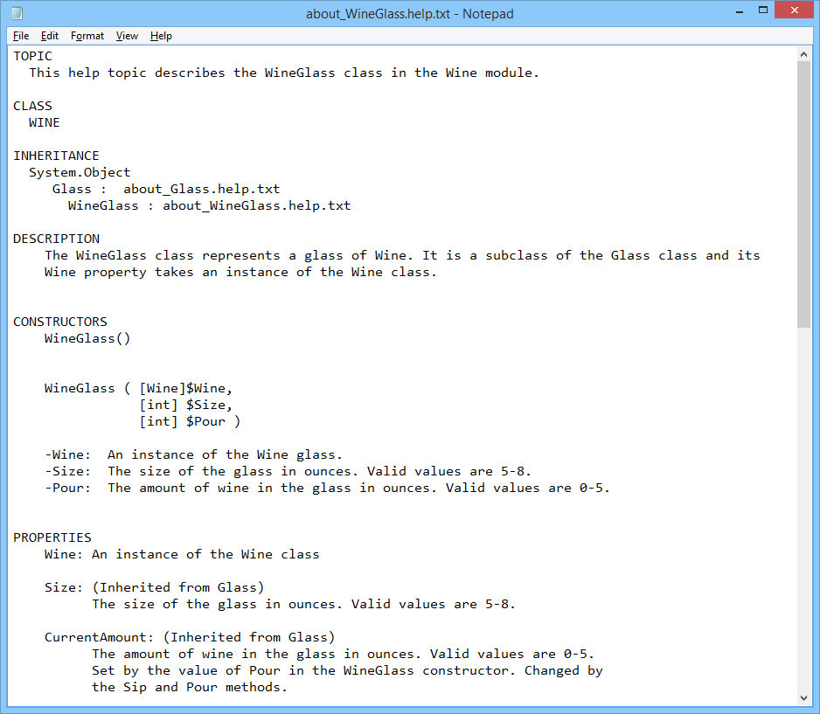
Help for DSC, Classes : About topics
about_WineGlass.help.txt

Slide 64
References
Troubleshooting Comment-Based Help Writing XML Help for Advanced Functions HelpUri v. HelpInfoUri
Naming Help Files (PS 3.0 only; not updated for 4.0+)
Checklists for Authoring PowerShell Help
How to Write Great Help Examples
Supporting Online Help (MSDN)
Slides and code for all help talks: PowerShell Help Deep Dive (GitHub) Use help as a code spec: Advanced Help for Advanced Functions
Use help examples as a test spec: https://github.com/juneb/PesterTDD

Slide 65
Professional Help for PowerShell Modules
June Blender
Technology Evangelist
SAPIEN Technologies, Inc.
Microsoft Cloud & Datacenter MVP
@juneb_get_help

